Slide 1
dotSwift 2019
Adam Gask & James Froggatt
Notes:
James
We'll take questions after each section

Slide 2
Conference Information
https://www.dotswift.io
Notes:
James
~3 mins

Slide 3


Conference Information
The European Swift Conference
28 January 2019
Paris
Théâtre de Paris
Notes:
James

Slide 4
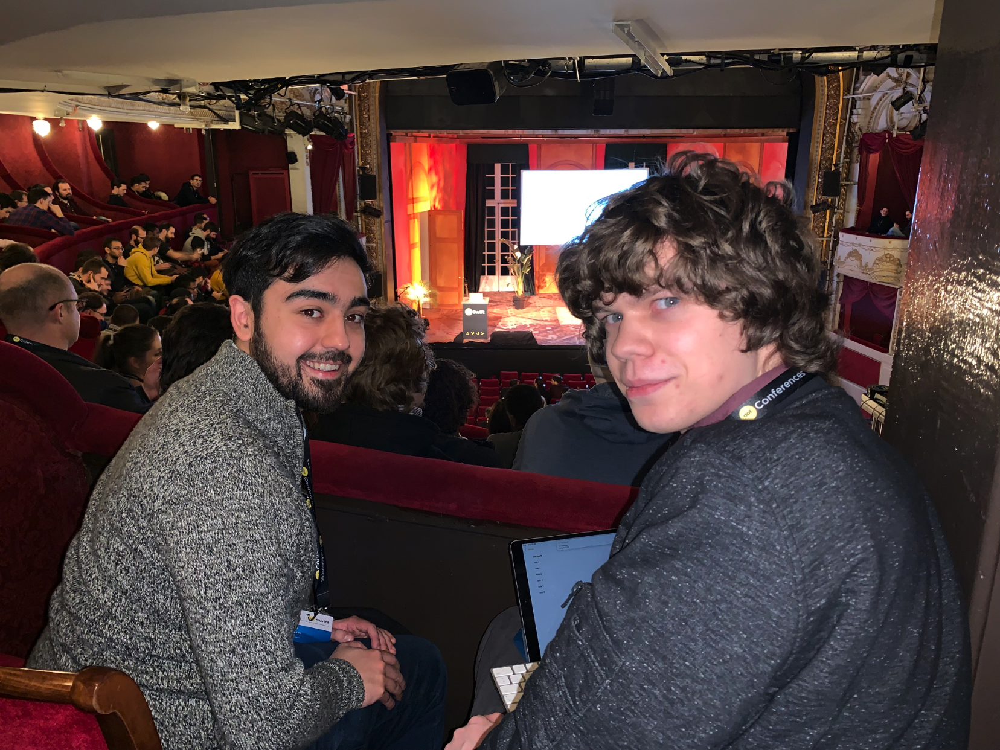
Théâtre de Paris
Notes:
James

Slide 5
Conference Information
Hosted by DotConferences (5 Years Running)
dotGo (The European Go Conference)
dotCSS (The largest CSS Conference in Europe)
dotJS (The largest JavaScript Conference in Europe)
dotSwift (The European Swift Conference)
dotAI (The Artificial Intelligence & Machine Learning Conference for Developers)
dotScale (The European Tech Conference on Scalability)
dotSecurity (The Security Conference for Developers)
Notes:
Adam

Slide 6

Conference Information
Format
8 Talks
5 Lightning Talks
¾ Day event
Two optional days of courses/workshops
Notes:
Adam

Slide 7
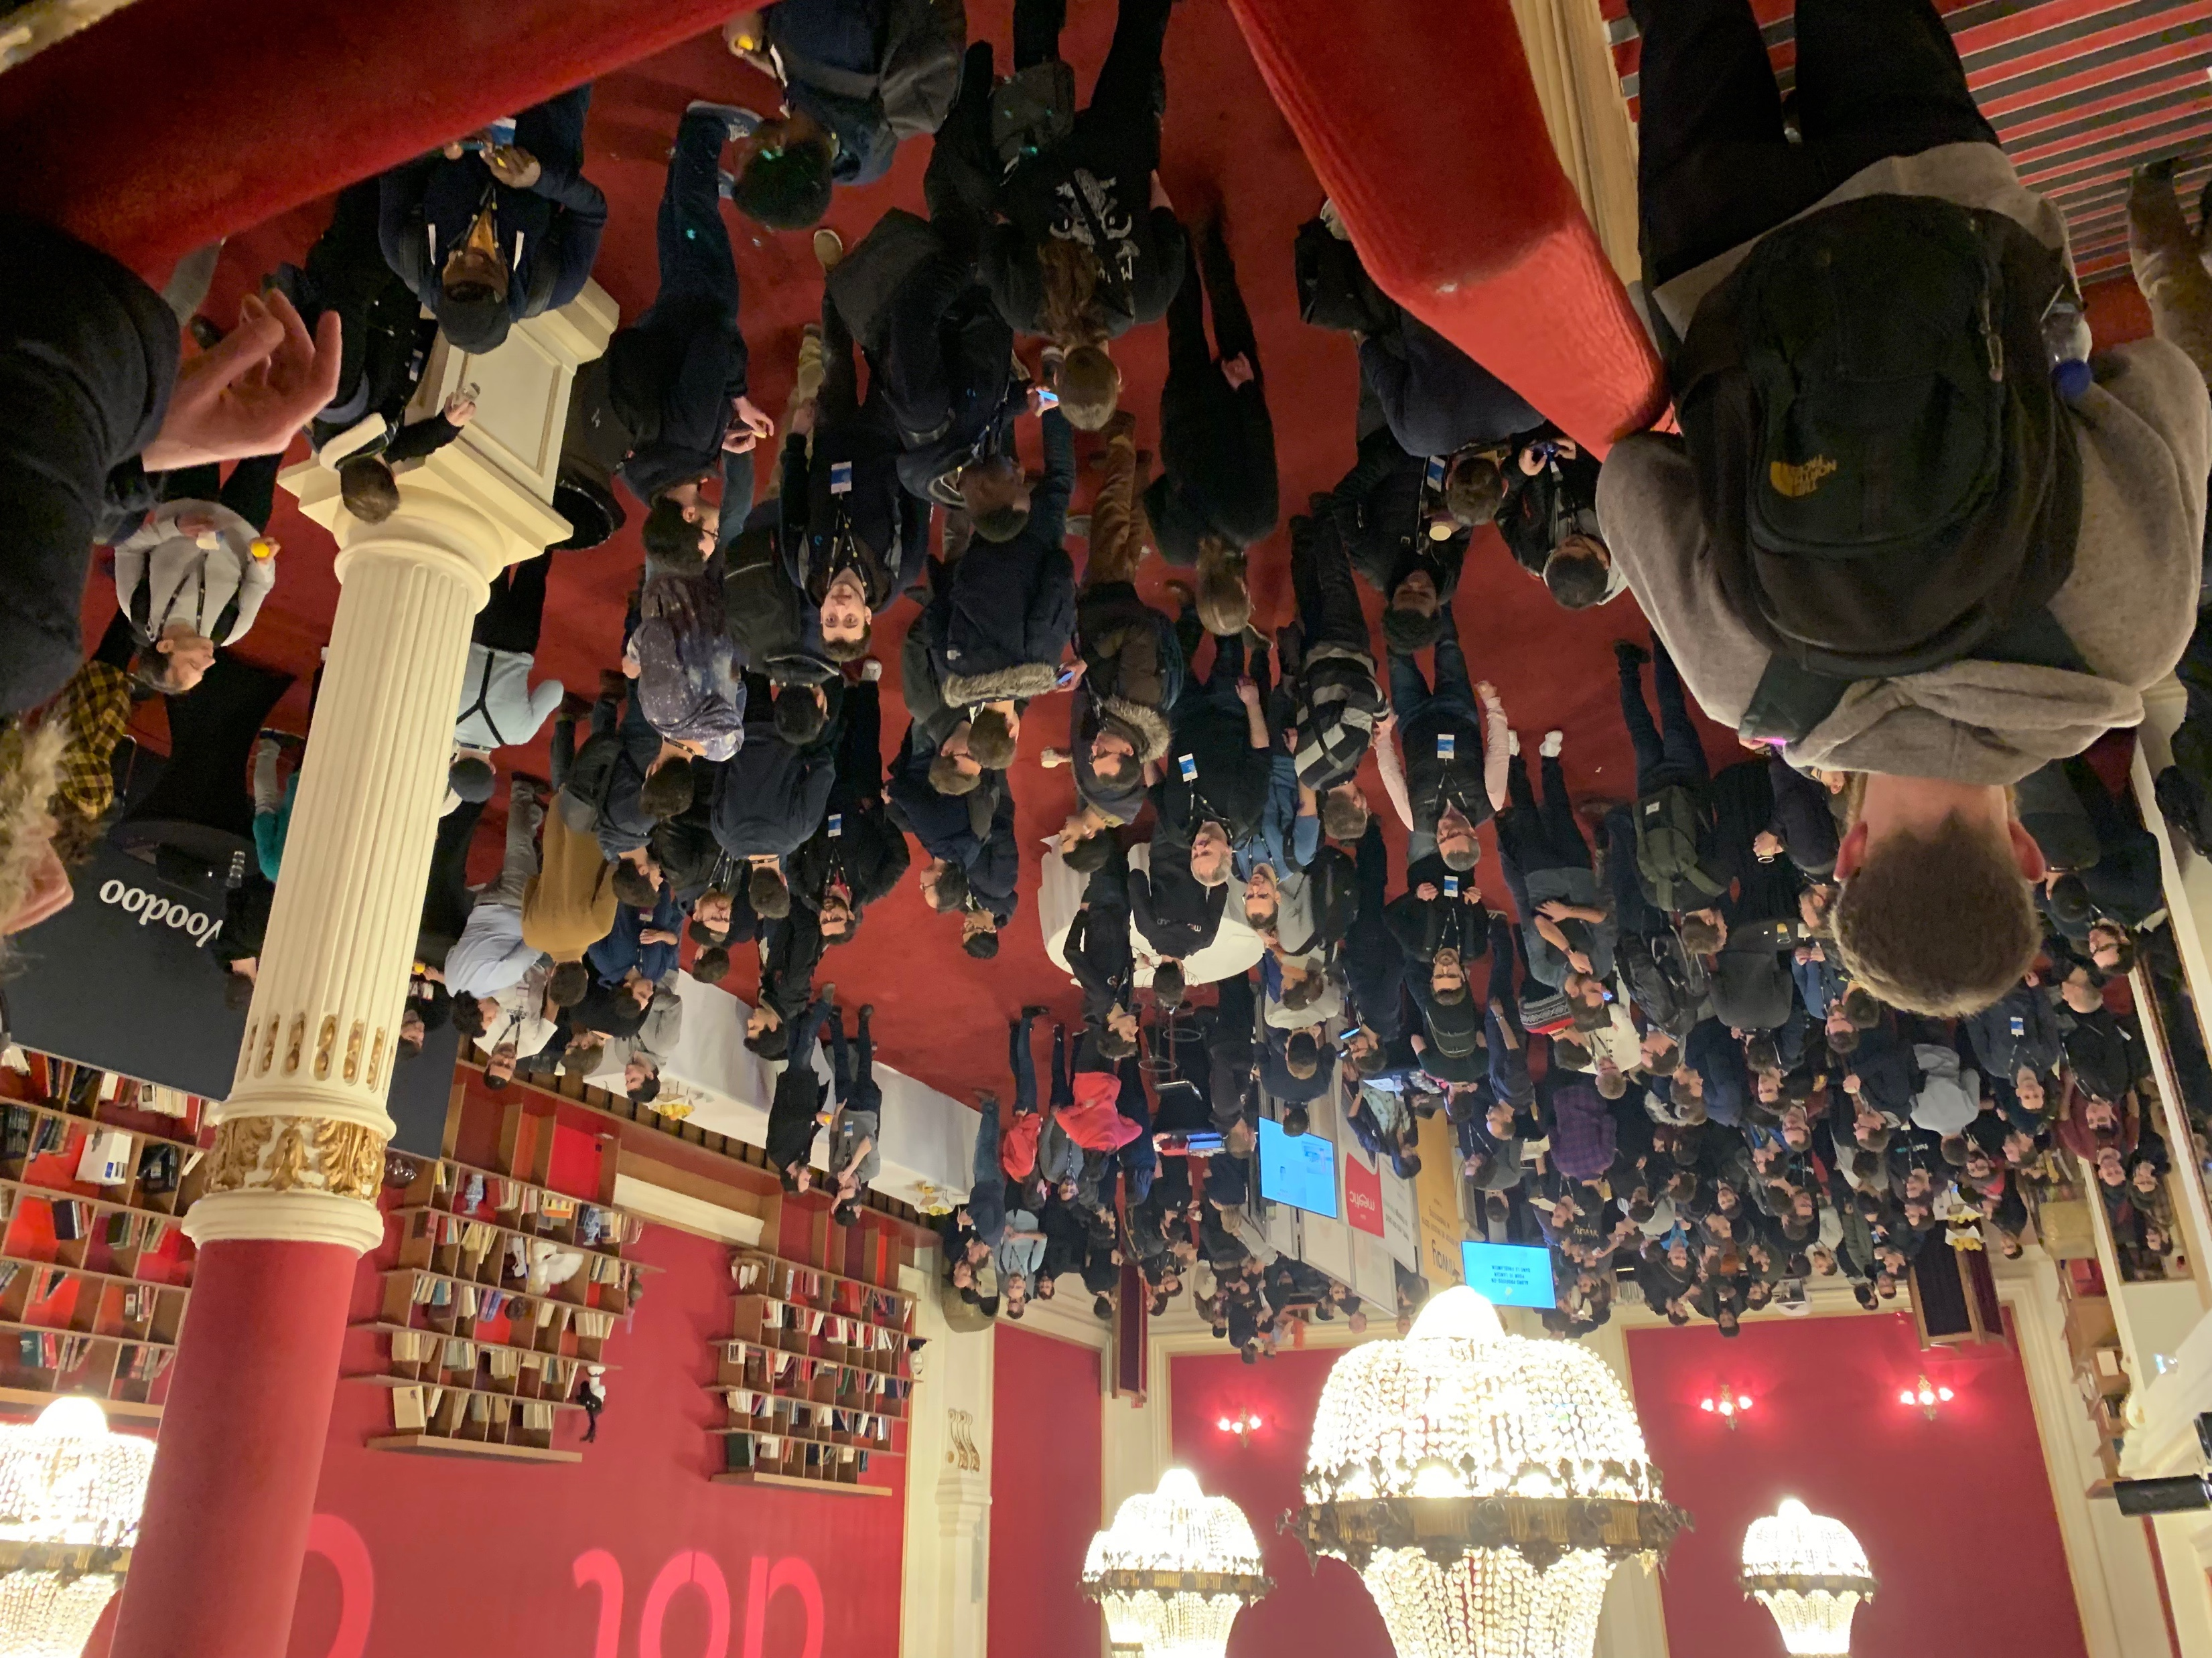
Lots of Coffee and Cake
Notes:
Adam

Slide 8
Key Speakers
Notes:
Adam ~5 mins, both

Slide 9



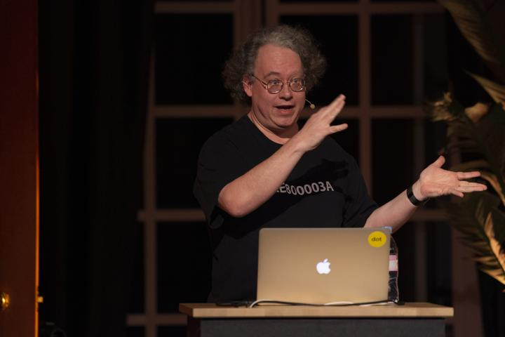
Key Speakers
Daniel Jalkut
Just Enough Objective-C (Combining Obj-C & Swift)
Saroush Khanlou
From Problem To Solution (Code Reuse)
Jeff Biggus
Scientific Swift
(Custom Operators & Unicode)
Mark Dalyrumple
Wh@t Is Th@t (Attributes)
Notes:
James Just Enough Objective-C – Making use of dynamic features from Objective-C in Swift
From Problem To Solution – Breaking down complex problems into simple components – hard to summarize but recommended viewing
Scientific Swift - Utilizing Swift’s support for custom Unicode operators to make code more readable
Wh@t Is Th@t (Attributes) – Using the open-source project to go behind the scenes

Slide 10
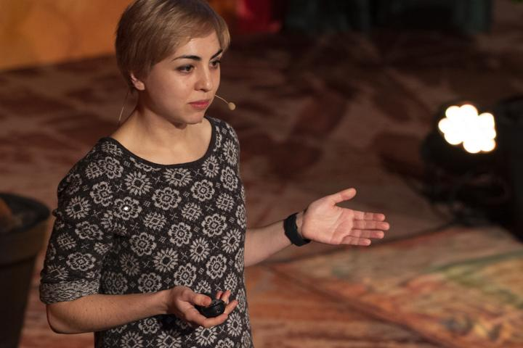


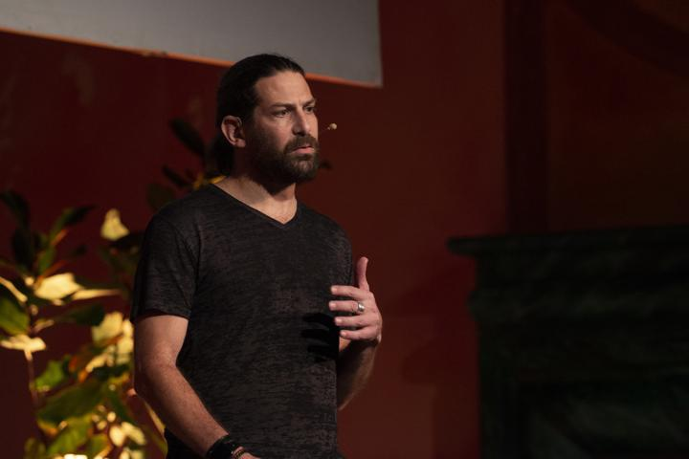
Key Speakers
Johannes Weiss (Apple Swift NIO)
High-Performance Systems In Swift (Structs vs Classes)
Lea Marolt Sonnenschein
Making Table Views Great Again! (Reusable patterns)
James Dempsey (former Apple)
Scripting In Swift (It’s a tradeoff)
Tom Doron (Apple Swift NIO) Implementing JSON-RPC with SwiftNIO
Notes:
Adam Ray Wenderlich

Slide 11
Just Enough Objective-C
Using the Objective-C runtime from Swift, private APIs
Daniel Jalkut, https://www.dotconferences.com/2019/01/daniel-jalkut-just-enough-objective-c
Notes:
~3 mins, James

Slide 12
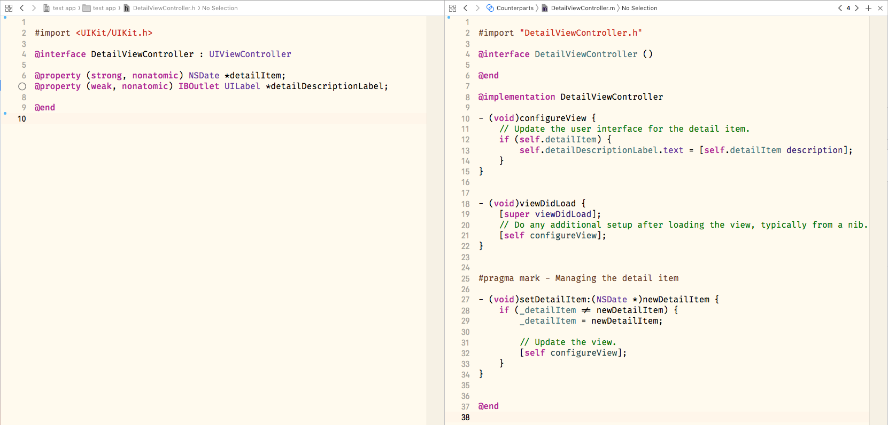
Objective-C Runtime
Objective-C defines types as a set of properties and methods.
Methods are declared with headers
Undeclared methods can still be accessed publicly – no API is truly ‘private’.
Internally, methods calls are string messages passed between objects.
Notes:
Obj-C defines types as a set of properties and methods.
Accesses to properties/methods compile to obj-c_msgSend.
Key-value observation is based on top of this.

Slide 13
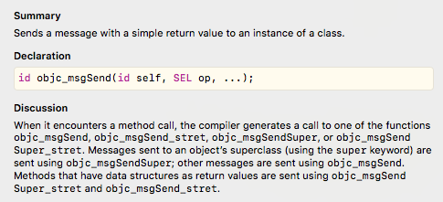
objc_msgSend
Compiles to…
See also, the Objective C Runtime framework: https://developer.apple.com/documentation/objectivec/objective-c_runtime?language=objc
Notes:
Callable in code, though not recommended.
Discussed at dotSwift.

Slide 14
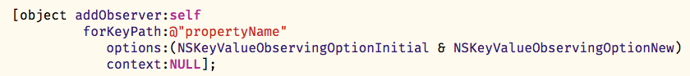
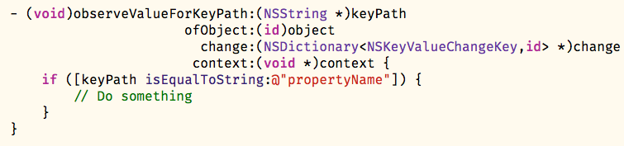
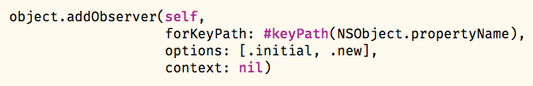
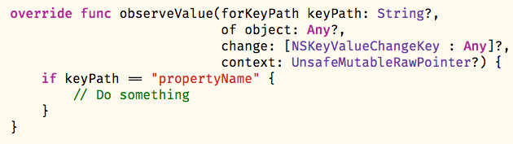
Key-Value Observation
Objective-C
Swift
Allows safe syntax for Obj-C keypath strings
Classic unsafe raw strings work too
Notes:
Usable in Obj-C and Swift, behaviour comes from NSObject.
Allows observation of property changes.
Swift: use string directly, or compiler checked alternative.

Slide 15
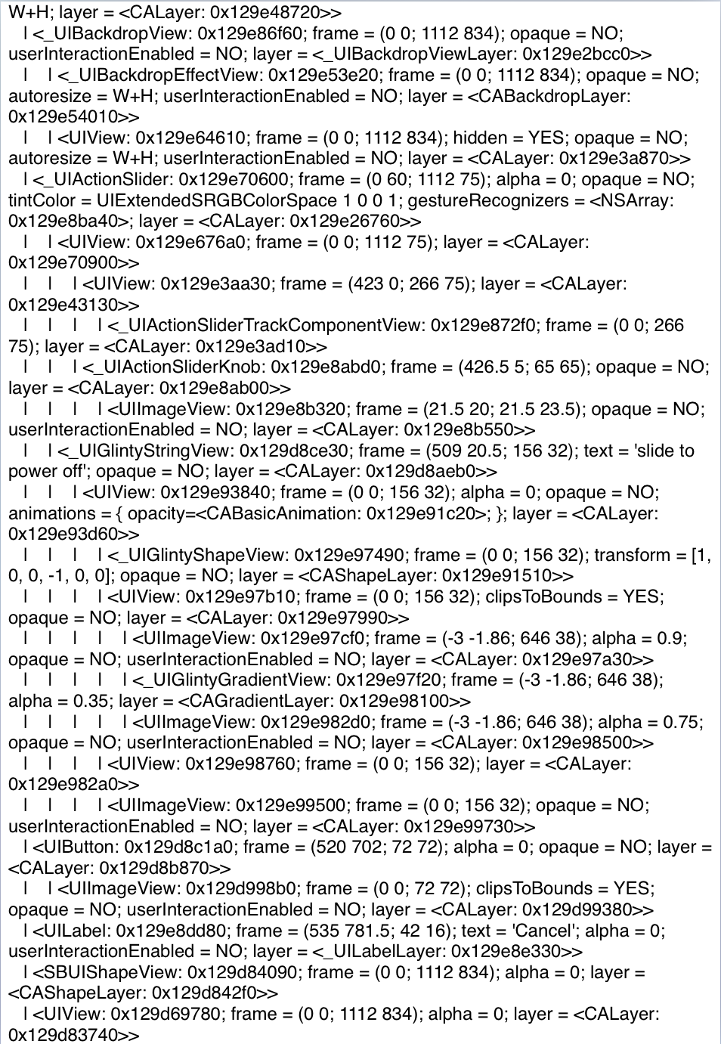
Private APIs
Notes:
Segue: What else do string messages allow?
UIView private property ‘recursive description’ prints the view hierarchy.
Can be called as shown.
Useful to know for debugging, Objective C underlies frameworks we use every day.

Slide 16
Wh@t Is Th@T (Attributes)
Swift open-source, going behind the scenes, find-ing
Mark Dalyrumple, https://www.dotconferences.com/2019/01/mark-dalrymple-what-is-that
Notes:
~4 mins, James

Slide 17
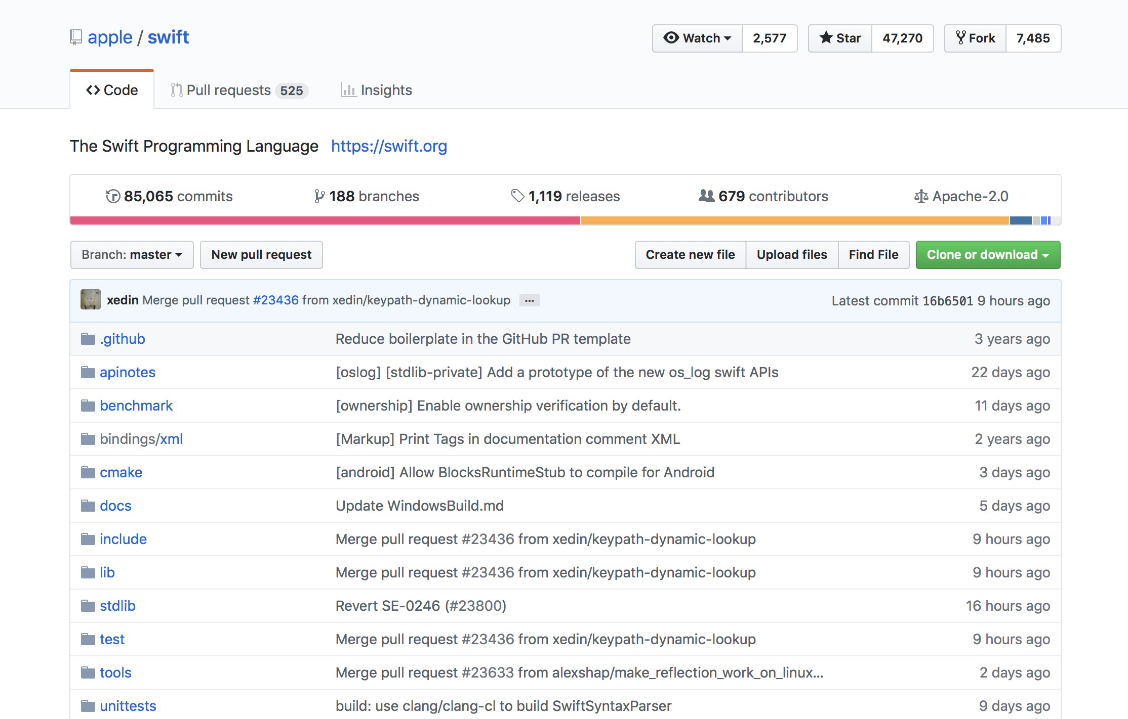
Swift Open-Source
The compiler:
Written in C++, hosted on Github
Hosted at https://github.com/apple/swift
Notes:
All open, available to browse for debugging, learning, and contributing.

Slide 18
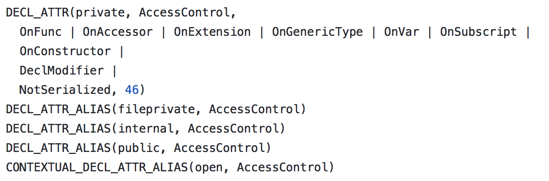
Find-ing things
find . -type f -exec grep SomethingInteresting {} \; -print
With a local clone of Swift compiler, this command lets you search the file contents from the command line, to find points of interest in the Swift compiler.
One such example is the file identifying each Swift attribute as a keyword:
https://github.com/apple/swift/blob/master/include/swift/AST/Attr.def
Access control keywords:
Notes:
This means finding things is easy
From Mark Dalyrumple, great for finding things from the command line.
Tool for self-directed learning.

Slide 19
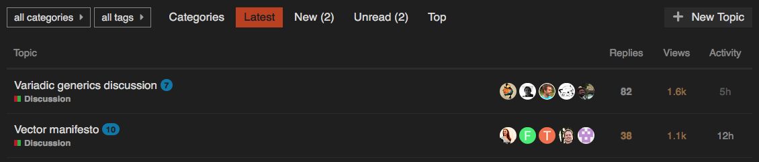
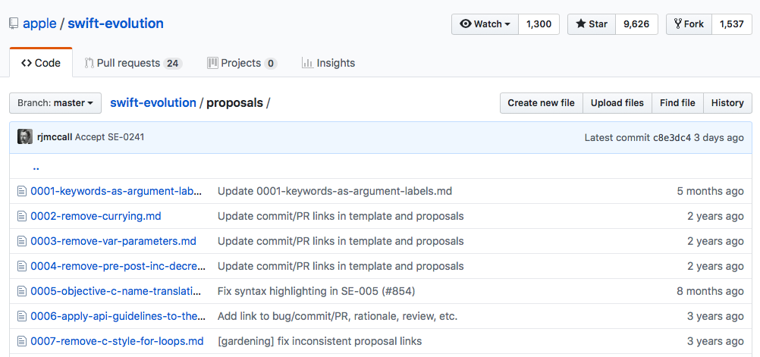
Swift Community
Swift.org:
Central location for learning about the Swift Project
Home of the Swift Blog, API Design Guidelines, and many useful links
Hosted at https://swift.org/
Swift Forums:
For evolution, development, community projects, and user questions
Gathering place for the Swift community
Not just Apple developers
Hosted at https://forums.swift.org
Notes:
Great way to learn and get involved as a user of Swift

Slide 20
Unicode support & defining operators
How Scientific Swift can be improved using unicode support
Jeff Biggus, https://www.dotconferences.com/2019/01/jeff-biggus-scientific-swift
Notes:
~3 mins, Adam

Slide 21
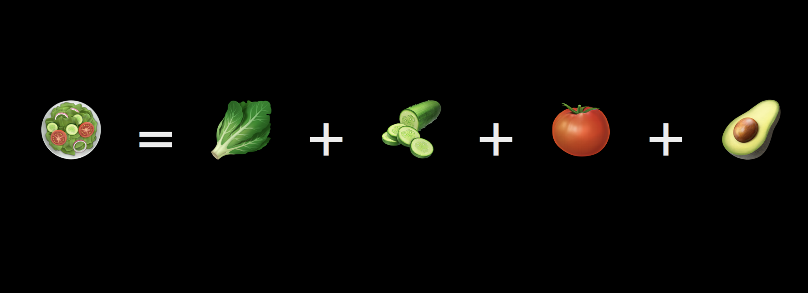
Unicode Support
Notes:
This means finding things is easy
From Mark Dalyrumple, great for finding things from the command line.
Tool for self-directed learning.

Slide 22
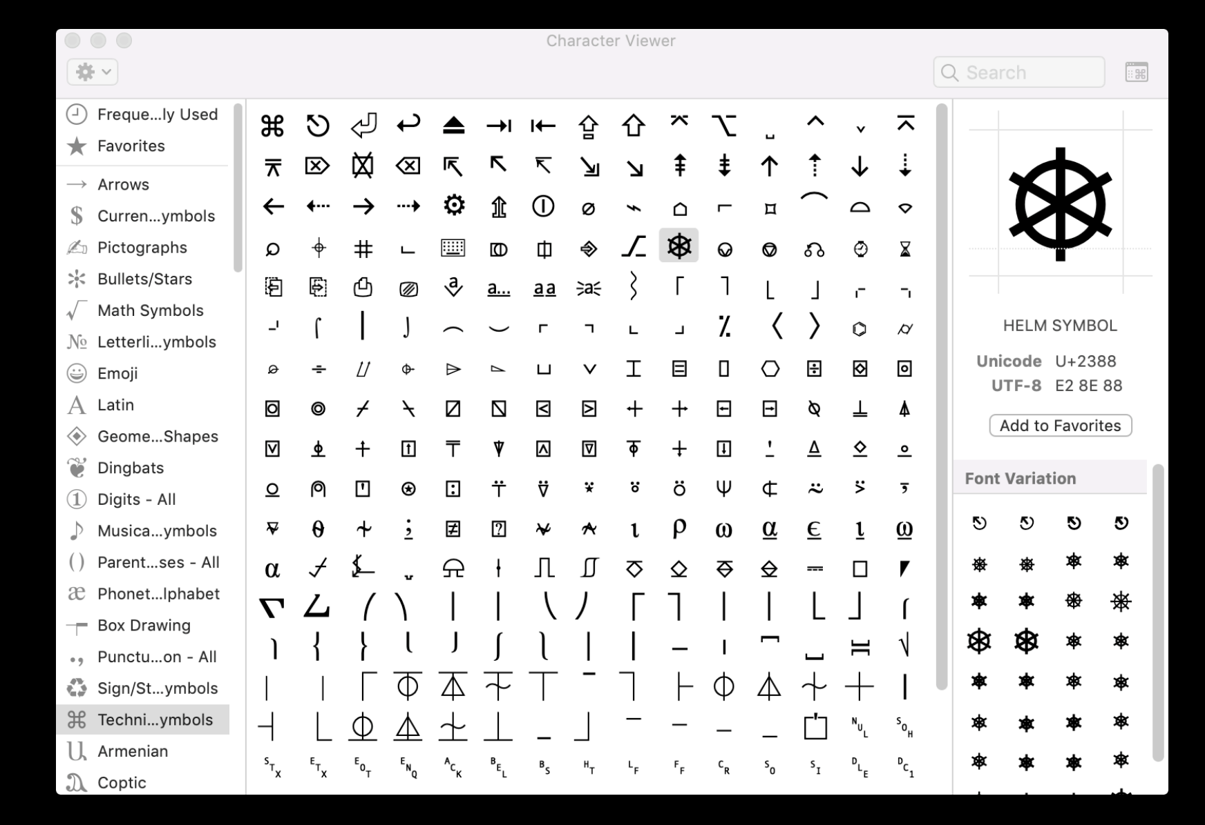
Unicode Support
Notes:
This means finding things is easy
From Mark Dalyrumple, great for finding things from the command line.
Tool for self-directed learning.

Slide 23
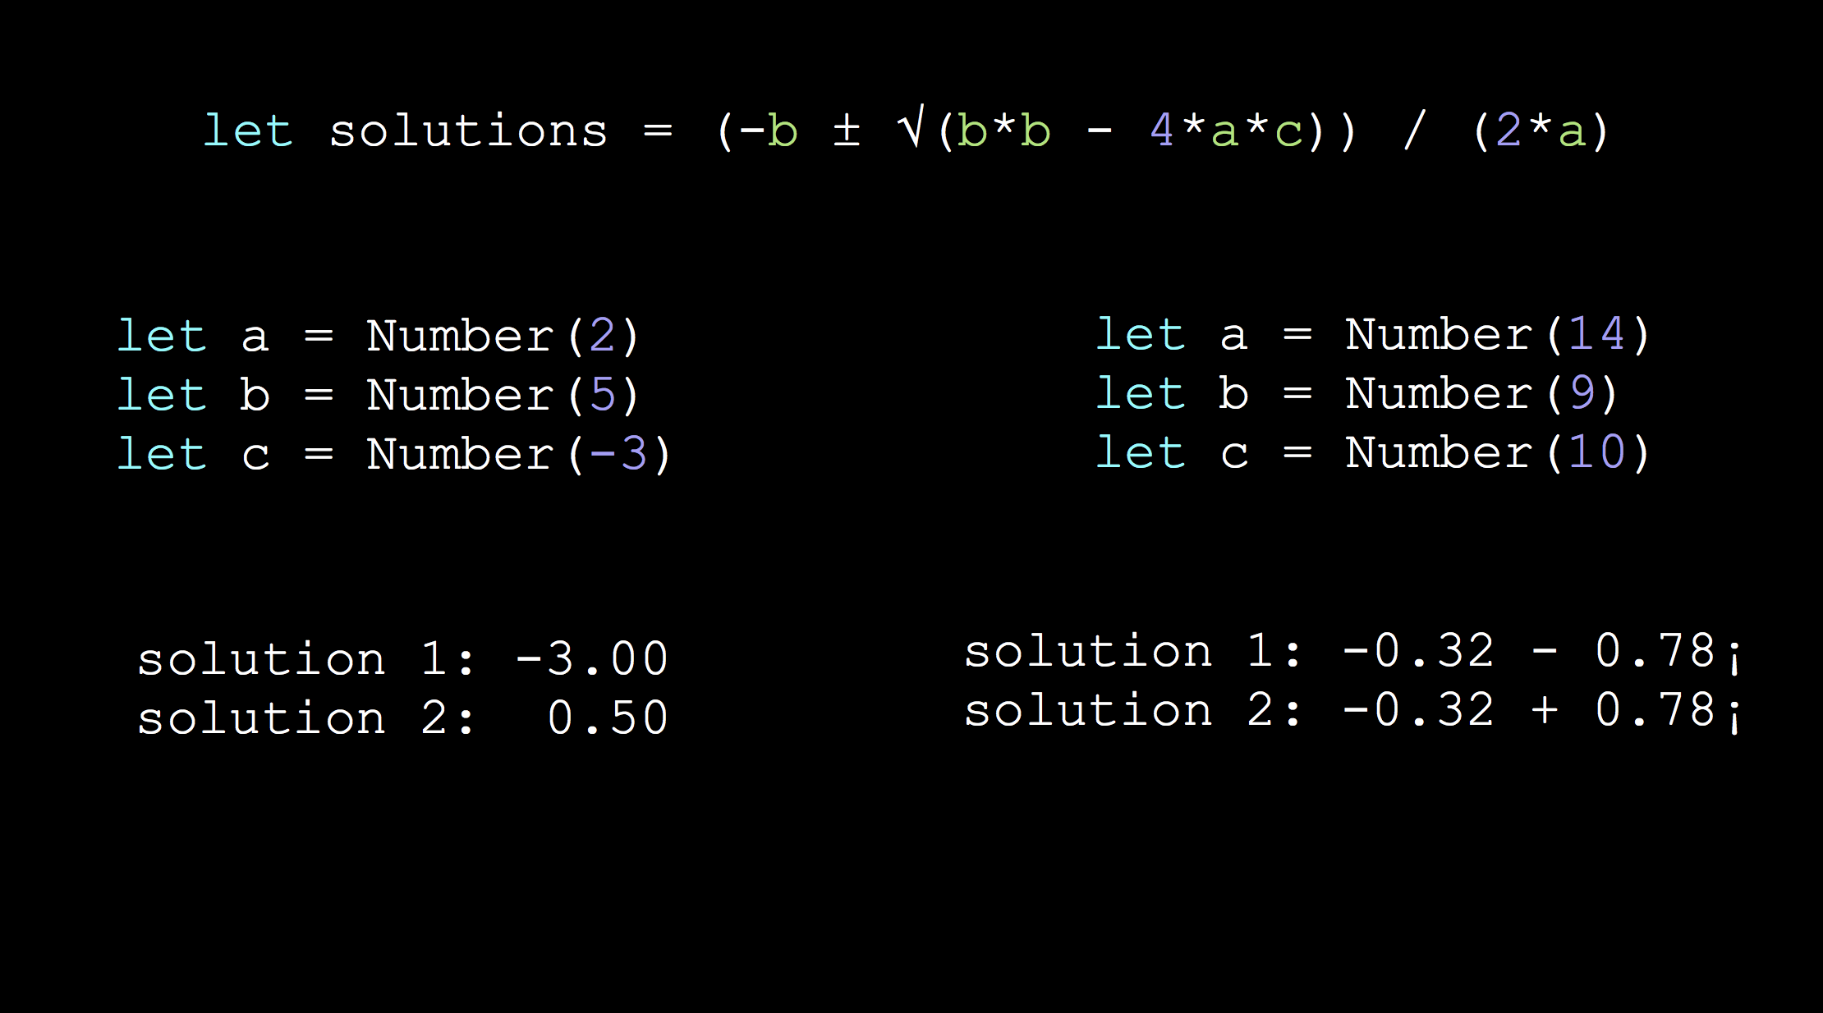
Unicode Support
Notes:
This means finding things is easy
From Mark Dalyrumple, great for finding things from the command line.
Tool for self-directed learning.

Slide 24
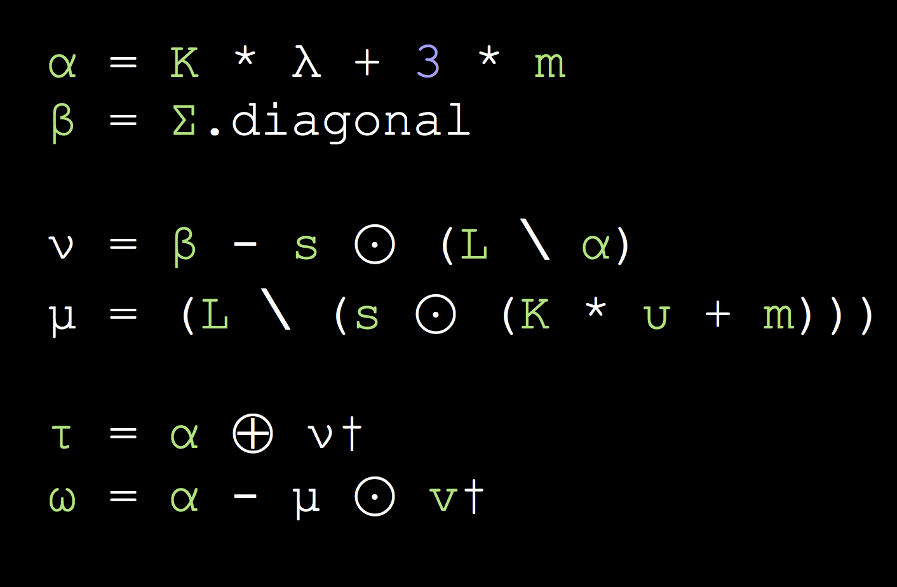
Unicode Support
Notes:
This means finding things is easy
From Mark Dalyrumple, great for finding things from the command line.
Tool for self-directed learning.

Slide 25
KeyPaths
Indices for the everyday object
Vincent Pradeilles, https://www.dotconferences.com/2019/01/vincent-pradeilles-the-underestimated-power-of-keypaths
Notes:
~5 mins, both

Slide 26
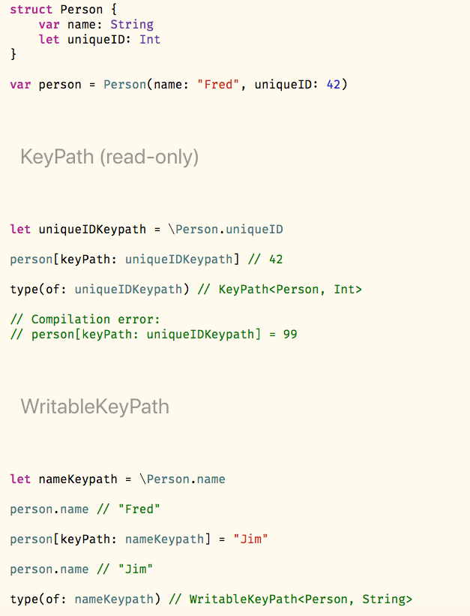
Overview
Try them with KeyPaths.playground
https://git.gbl.experiancs.com/jfroggatt/ukmobile-dotSwift-2019
Keypaths let you read & write to a property of an object
They work similar to array indices or dictionary keys:
object[keyPath: \.property] = newValue
Notes:
James

Slide 27
Type Hierarchy
Try them with KeyPaths.playground
https://git.gbl.experiancs.com/jfroggatt/ukmobile-dotSwift-2019
Types are generic:
KeyPath<TypeWithProperty, PropertyType>
Read & Write support is determined by the type:
Type | Access
KeyPath | Read-only
WritableKeyPath | Read-write
Notes:
James

Slide 28
Type Safety
Try them with KeyPaths.playground
https://git.gbl.experiancs.com/jfroggatt/ukmobile-dotSwift-2019
Attempting to write to a read-only KeyPath is a compilation error
Literals resolve to the appropriate type:
\.readOnlyProperty → KeyPath
\.readWriteProperty → WritableKeyPath
Notes:
Adam

Slide 29
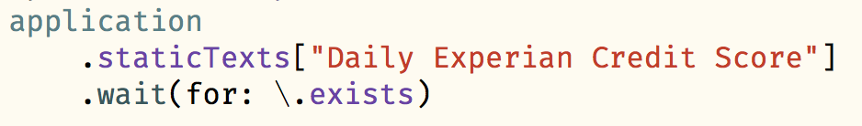
Usage
Try them with KeyPaths.playground
https://git.gbl.experiancs.com/jfroggatt/ukmobile-dotSwift-2019
We use KeyPaths in the Experian app for enhanced readability.
Examples:
Notes:
Adam
Clean, readable syntax
See playground for more

Slide 30
Marzipan
overview
Notes:
~2 mins, Adam
Ported Apple apps example

Slide 31
Marzipan
"Project Marzipan" announced last year (WWDC 2018)
Aimed to be released this year (2019)
Goal:
To build MacOS apps using UIKit
Handles system appearance automatically
Window Toolbar
Menu Bar
Touchbar Controller

Slide 32
Marzipanify
https://github.com/steventroughtonsmith/marzipanify
An unsupported commandline tool to convert iOS binaries to macOS
You currently need to disable a load of security features for it to work
Marzipan official should be supported/released in beta WWDC 2019
Notes:
- How it actually works in code
-

Slide 33
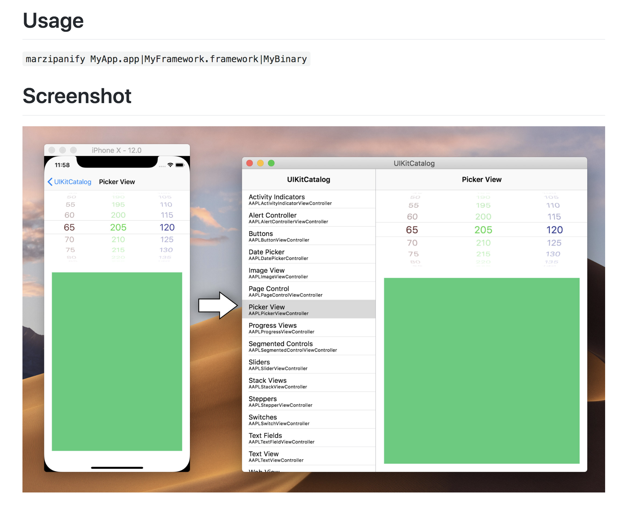
Notes:
- How it actually works in code
-

Slide 34
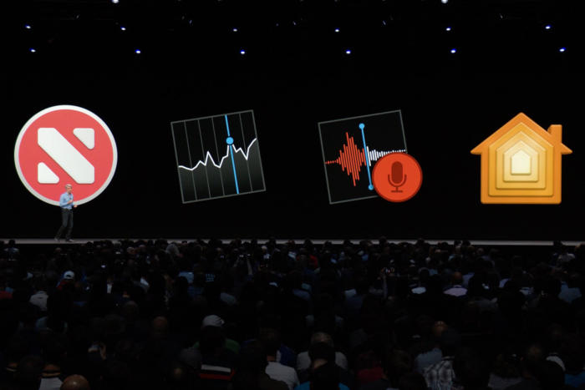
Notes:
- How it actually works in code
-

Slide 35
High Performance Systems In Swift
Structs, classes, and copy-on-write
Johannes Weiss, https://www.dotconferences.com/2019/01/johannes-weiss-high-performance-systems-in-swift
Notes:
~8 mins, James

Slide 36
Playground example
Classes, Structs, & Copy-On-Write
https://git.gbl.experiancs.com/jfroggatt/ukmobile-dotSwift-2019
Notes:
Point out playground is available online before

Slide 37
Wrap-up, thoughts, & experiences
Notes:
Adam
~1 min, both
~48 mins total

Slide 38
Wrap-up, thoughts, & experiences
Many top speakers from the industry
Advanced topics, highly relevant to a broad range of app developers
Lots of cake 🍰
Some very specialist lightning talks
Venue was well suited for the event
We would go back again 🇫🇷
Notes:
Adam – first 3
James – last 3

Slide 39

Questions?

